Slide 1
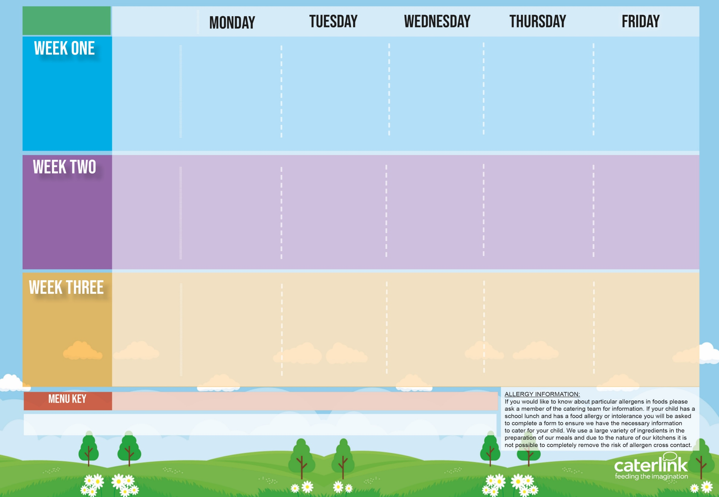
Spring Summer
2024
Option One
Option Two
Vegetables
Dessert
NEW Vegetable Stack with Rice | Penne Bolognaise | Roast Chicken, Mashed Potatoes, Yorkshire Pudding & Gravy | Greek Chicken Pitta with Rice, Tzatziki & Salad or Cheese Whirl with Rice, Tzatziki & Salad | Fishfingers with Chips & Tomato Sauce
Cheese & Tomato Pizza with Pasta Salad | Vegan Penne Bolognaise | Vegan Sausages, Roast Potatoes & Gravy | or Cheese Whirl with *Rice and Salads | BBQ Quorn with Chips
Vegetables of the Day | Vegetables of the Day | Vegetables of the Day | Vegetables of the Day | Vegetables of the Day
Freshly Chopped Fruit Salad | Apple Crumble with Ice Cream | NEW Berry Mousse | Iced Vanilla Sponge | Vanilla Shortbread
15/04/2024
06/05/2024
03/06/2024
24/06/2024
15/07/2024
09/09/2024
30/09/2024
Option One
Option Two
Vegetables
Dessert
Pasta Kitchen Tomato Pasta or Carbonara Pasta with Toppings | Burger with Potato Wedges & Tomato Sauce | Roast Chicken, Stuffing, Mashed Potatoes, Yorkshire Pudding & Gravy | Beef Lasagne with Garlic Bread | Fishfingers or Salmon Fishfingers with Chips & Tomato Sauce
 | Vegan Burger with Potato Wedges & Tomato Sauce | Vegetable Wellington, Stuffing, Roast Potatoes & Gravy | Vegetable Curry with Rice | NEW Vegan Sausage Roll with Chips & Tomato Sauce
Vegetables of the Day | Vegetables of the Day | Vegetables of the Day | Vegetables of the Day | Vegetables of the Day
NEW Chocolate Brownie | NEW Iced Biscuit | Fruit Medley | Jelly with Mandarins | Oaty Cookie
22/04/2024
13/05/2024
10/06/2024
01/07/2024
22/07/2024
16/09/2024
07/10/2024
Option One
Option Two
Vegetables
Dessert
NEW All-Day Vegetarian Breakfast | Chicken Paella with Patatas Bravas or Veggie Meatballs with Patatas Bravas | Roast Chicken, Mashed Potato, Yorkshire Pudding & Gravy | NEW Chicken Fajitas with Rice | Fishfingers with Chips & Tomato Sauce
Vegan Chilli with Rice | or Veggie Meatballs with Patatas Bravas | Parsnip & Sweet Potato Loaf with New Potatoes or Mashed Potatoes & Gravy | Macaroni Cheese | Cheese & Bean Pasty with Chips
Vegetables of the Day | Vegetables of the Day | Vegetables of the Day | Vegetables of the Day | Vegetables of the Day
Fruit with Ice Cream | Syrup Snap Biscuit | Fruit Platter | Chocolate Shortbread | Summer Lemon Cake
29/04/2024
20/05/2024
17/06/2024
08/07/2024
02/09/2024
23/09/2024
14/10/2024
Added Plant Power
Wholemeal
Vegan
Chef’s Special
Available Daily: - Freshly cooked jacket potatoes with a choice of fillings - Bread freshly baked on site daily- Daily salad selection

