Slide 1
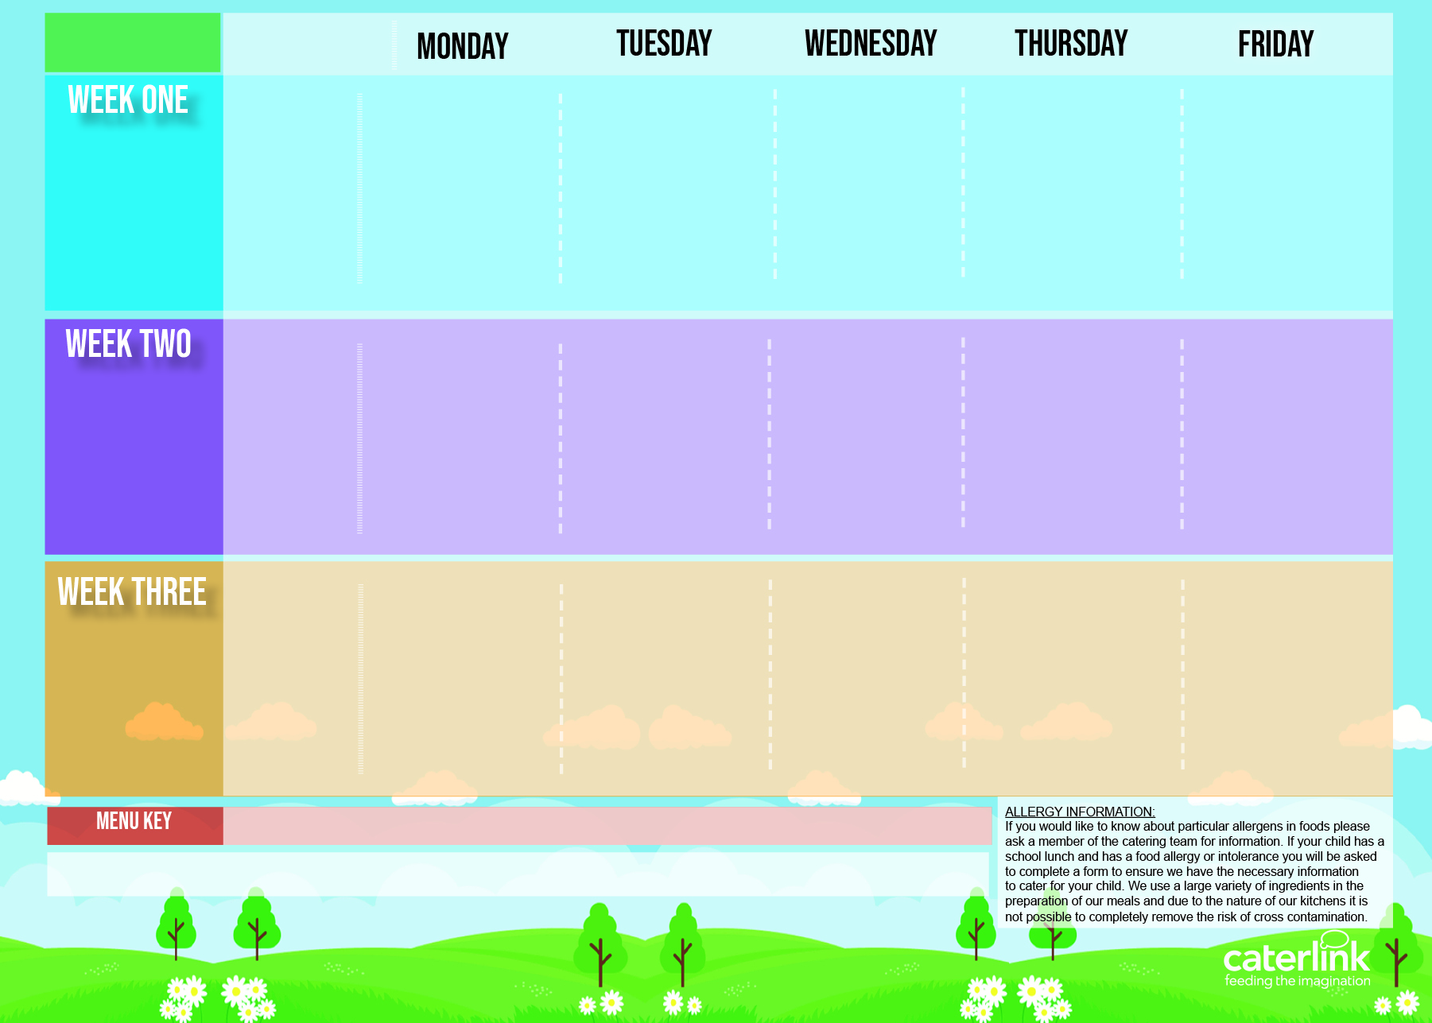
Autumn/ Winter
2023/ 2024
Option one
Cheese and Tomato Pizza with Pasta Salad
A choice of Burger (Beef & Bean or Vegan) with Toppings and Potato Wedges
Roast of the Day, Stuffing Mashed Potatoes, & Gravy
Spaghetti Bolognaise with Garlic Bread
Fishfingers with Chips & Tomato Sauce
30/10/2023
20/11/2023
11/12/2023
15/01/2024
05/02/2024
04/03/2024
25/03/2024
Option two
NEW Chef Mariam’s Vegetable Couscous
Veg Wellington, Stuffing, Roast Potatoes & Gravy
Veggie Bolognaise with Garlic Bread
Cheesy Bean Pasty with Chips & Tomato Sauce
Vegetables
Vegetables of the Day
Vegetables of the Day
Vegetables of the Day
Vegetables of the Day
Vegetables of the Day
Dessert
Lemon Drizzle
Fruit Jelly
with Mandarins
Freshly Chopped Fruit Medley
NEW Jam and Coconut Sponge
Oaty Cookie
Option one
Tomato Pasta
Sausage Roll with Potato Wedges
Roast of the Day, Stuffing, Mashed Potatoes & Gravy
Breaded Fish Fillet with Chips & Tomato Sauce
06/11/2023
27/11/2023
18/12/2023
22/01/2024
19/02/2024
11/03/2024
A choice of BBQ or Lemon & Herb Chicken or Vegan Quorn, with Seasoned Potatoes and Salads
Cheesy Swirl with New Potatoes
NEW Loaded Jackets
Cheese Omelette with Chips & Tomato Sauce
Option two
Veggie Meatballs in Tomato Sauce with Rice
Vegetables
Vegetables of the Day
Vegetables of the Day
Vegetables of the Day
Vegetables of the Day
Vegetables of the Day
Chocolate Drizzle Cake with Chocolate Sauce
Dessert
NEW Carrot Cake
Apple Crumble with Custard
Fruit Medley
Vanilla Shortbread
NEW
A choice of Tomato or Carbonara Pasta with Toppings
Sausages, Onions and Gravy with Roast Potatoes
Roast of the Day, Stuffing Mashed Potatoes, & Gravy
Chicken Pie with
Mashed Potatoes
Fishfingers or Salmon Fishcake with Chips & Tomato Sauce
Option one
13/11/2023
04/12/2023
08/01/2024
29/01/2024
26/02/2024
18/03/2024
Option two
Veggie Sausages, Onions and Gravy with Roast Potatoes
Vegetable Fajitas with Rice
Macaroni Cheese
BBQ Quorn Fillet with Chips
Vegetables
Vegetables of the Day
Vegetables of the Day
Vegetables of the Day
Vegetables of the Day
Vegetables of the Day
Dessert
Iced Sponge
NEW Chocolate
Orange Cookie
Fruit Platter
Peach Upside Down Cake
with Custard
NEW Melting Moment
Biscuit
Added Plant Power
Wholemeal
Vegan
Chef’s Special
Available Daily: - Freshly cooked jacket potatoes with a choice of fillings - Bread freshly baked on site daily- Daily salad selection

