Slide 1
Year 3 and 4 Grafham Water
Monday 4th to Wednesday 6th of March
2024

Slide 2
Grafham Water Activity Centre
Owned by Cambridge County Council
Over 40 years experience of providing residentials to children
Excellent safety record
Qualified and experienced staff
Near St Neots, 20 miles from Whittlesey

Slide 3
A short video of one child’s experience
https://youtu.be/XP1OxYKn2SI

Slide 4
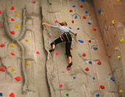
Climbing

Slide 5
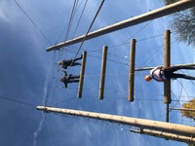
High Ropes

Slide 6
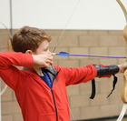
Archery

Slide 7
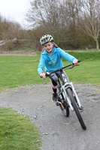
Mountain Biking

Slide 8
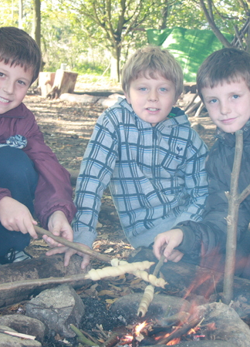
Bushcraft

Slide 9
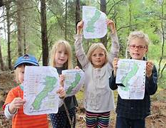
Orienteering

Slide 10
Power Boating

Slide 11
Staff
Mr Litten
Mrs Williams
Mr Adams
Miss Alegre
Miss Hibbins (half)
Mr Blake (half)

Slide 12
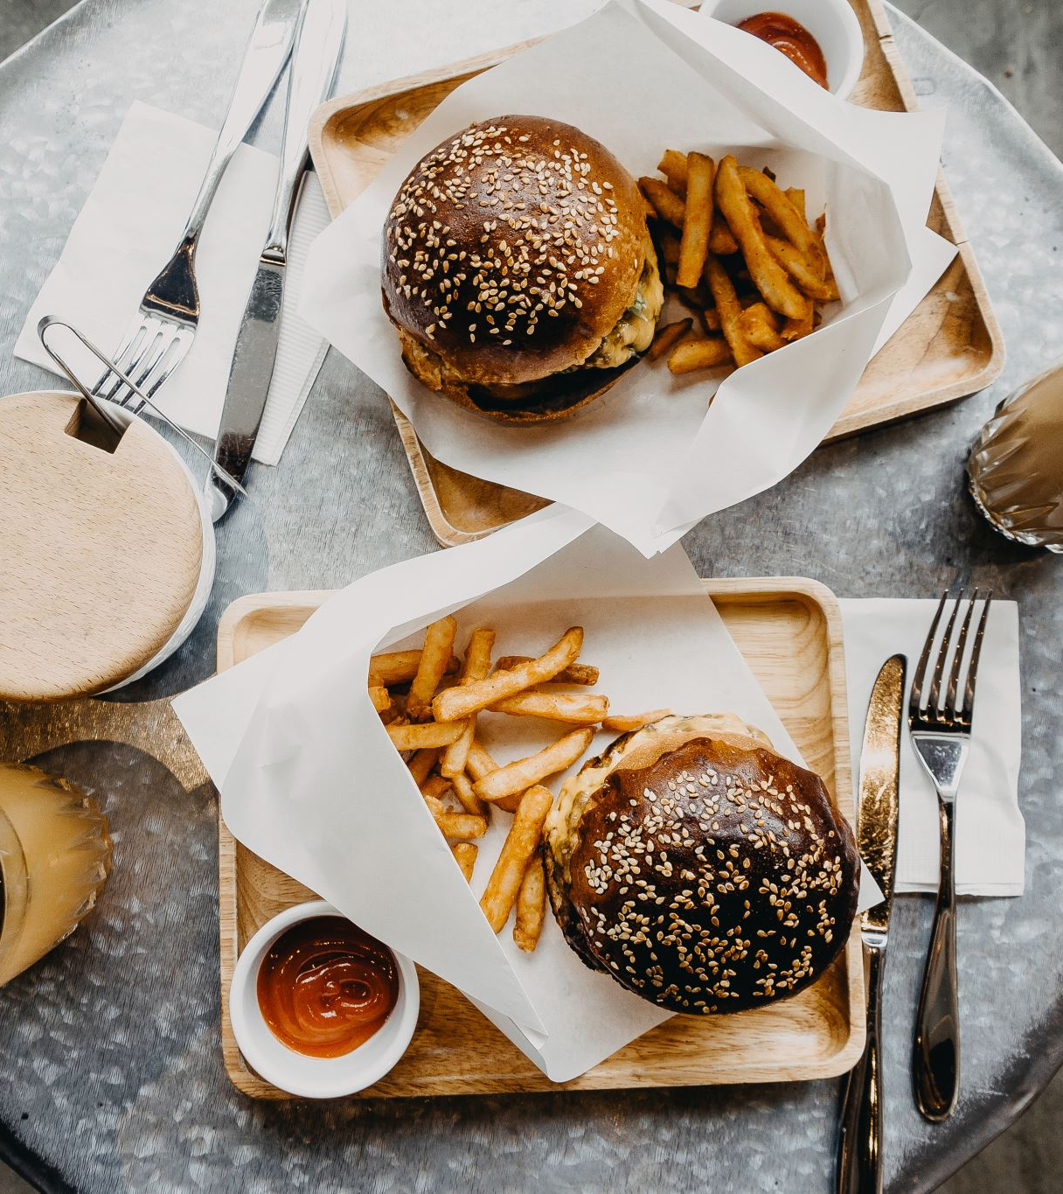
Food
Packed lunch required for the first day.
All meals provided thereafter
A favourites menu such pasta, roast chicken, burger
Salad Bar
‘Fussy eaters’ catered for.

Slide 14
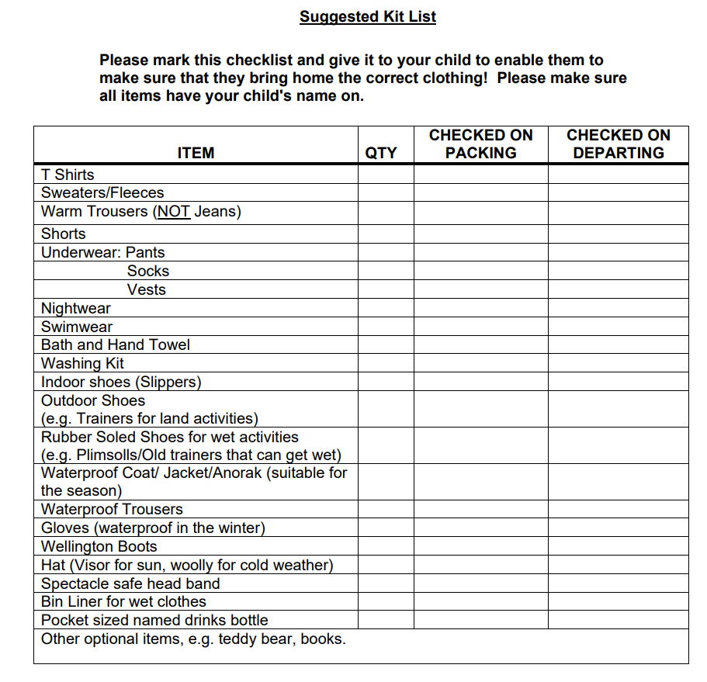

Slide 15
Link for further information
Schools, Colleges & Youth Groups - Grafham Water Centre (grafham-water-centre.co.uk)

Slide 16
Payment Schedule
Initial deposit of £35 by Friday
8th of September
£50 1st of November
£50 1st December
£50 1st January
£50 1st February
Total cost of the trip £235

Slide 17
Any Questions?

